Slide 1




Coastal Climate Change & Adaptation
Dan Lane, IOI-Canada,
Co-Director – C-Change (Canada)
Professor Emeritus,Telfer School of Management, University of Ottawa
Presentation to the China- ASEAN Advanced Academy on Oceans Law & Governance 2, NISCSS Haikou, Hainan
PART 2 – Afternoon, November 12, 2016

Slide 2
Coastal Climate Change & Adaptation – Outline
PART I - Morning
Introduction
Challenges for the 21st Century – Coastal Zones
Understanding Adaptation Needs – Profiling
Pillars of Sustainability – Reflecting Importance**
PART II - Afternoon
Vulnerability Assessment
Estimating Coastal Impacts
Adaptation Problem Solving and Strategy Options
Evaluating Decisions**
Climate Change Governance
**Class Assignment

Slide 3
5. Assessing Vulnerabilities

Slide 4
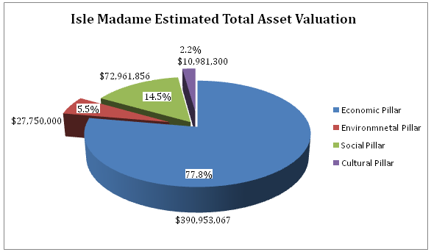
Isle Madame Asset (Pakdel 2011)

Slide 5
Asset - At-Risk Assessment- Damage Model
Total Asset Value
Asset at risk value
Actual damage value

Slide 6
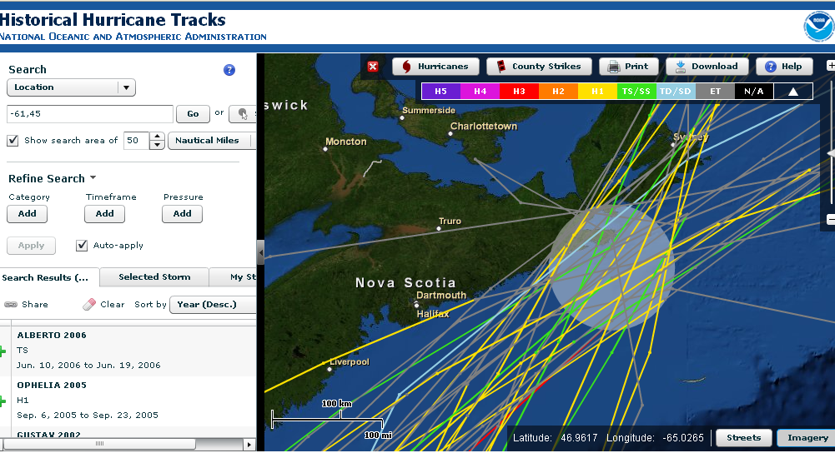
Isle Madame Storms Review

Slide 7
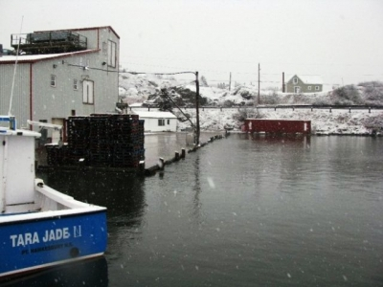
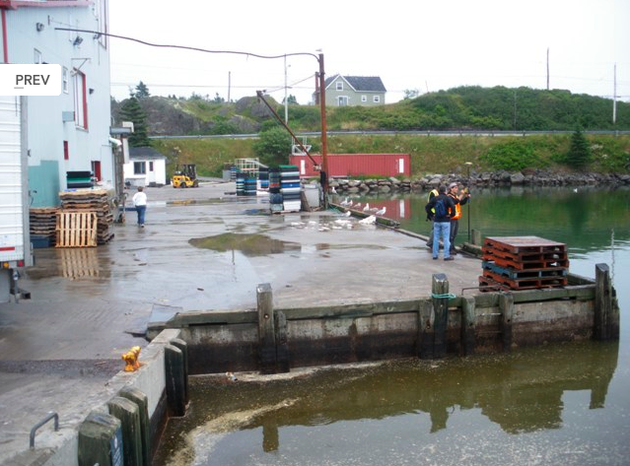
Assessing Vulnerability
Premium Crab plant –
Jan 2, 2010 “No Name” storm
Source:
www.coastalchange.ca Gallery

Slide 8
6. Estimating Coastal Impacts

Slide 9
Isle Madame
Total Estimated Damage Costs
for Storm Scenarios I-VI

Slide 10
Université Sainte Anne
Isle Madame Vulnerability
Report
Report Prepared by:
Aleasha (Boudreau) David,
Recherchiste,
Centre de recherche marine
and
Michelle Thériault,
Coordinatrice,
Centre de recherche marine

Slide 11
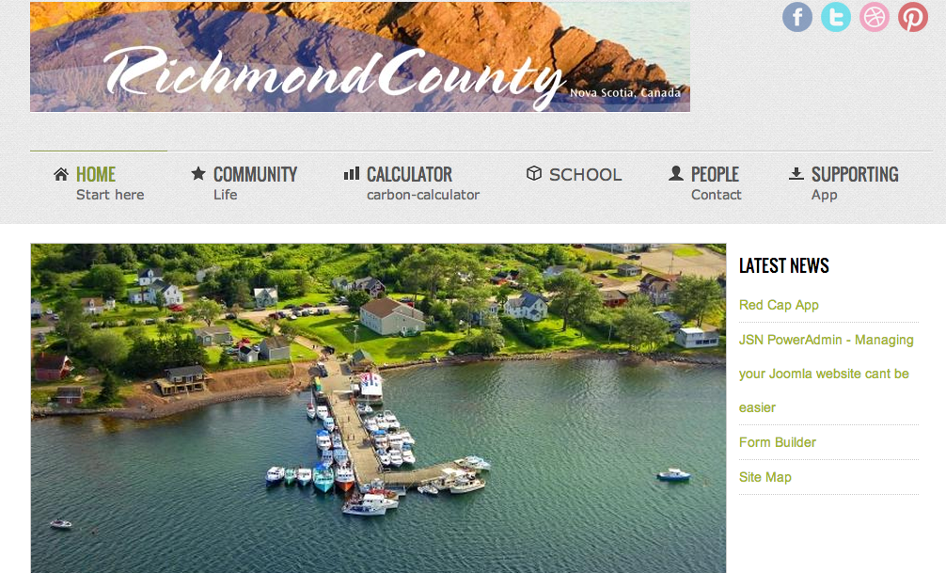
Proposed Climate Change Website for Richmond County
Lu (2013)

Slide 12
Problem: Little Anse Breakwater

Slide 13
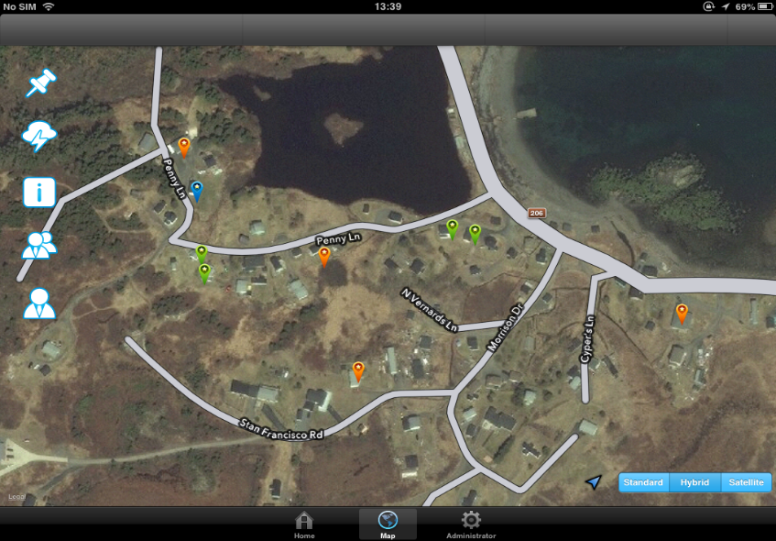
Richmond County Emergency Preparedness App
for iPad/iPhone/Smart phones Lu (2013)

Slide 14
7. Adaptation Problem Solving and Strategy Options

Slide 15
Adaptation Problem Solving
Profile the Community (Problem Definition & Data)
  GIS, local issues, key participants, identify community preferences, pairwise comparison (tradeoffs) - AHP
Assess Vulnerability “hotspots” (Data Analysis)
  Determine potential impacts based on historical events, develop adaptation alternatives and options, costs
Simulate Strategic Systems (Modelling & Analysis)
  System dynamics modelling, strategic planning period
Evaluate Strategy Alternatives
  Apply indices for Vulnerability, Resilience, Adaptive Capacity
Recommend, Implement & Monitor

Slide 16
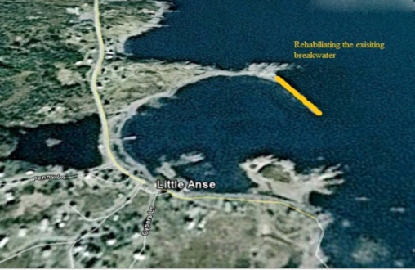
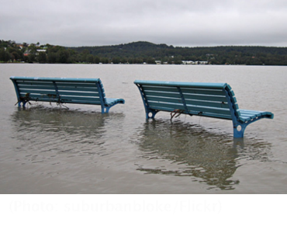
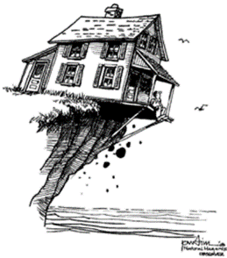
Adaptation Strategy Options (Pilkey & Young 2009)
1. Protect
Hard armouring (sea walls, groins)
Soft armouring (mangroves, wetlands)
No changes to buildings or use
Costly - Requires expert design, needs periodic maintenance and upgrading
2. Accommodate
Continued use of lands / structures, with some changes
Low costs / Low regrets
No costs / No regrets (mangroves)
3. Retreat
Accept flooding and damage will occur
Protect/accommodate not feasible
Change uses, move structures
4. Do Nothing
16

Slide 17
Strategic Systems Simulation
Development of specific adaptation strategies
  Protect, Accommodate, Retreat, Status Quo (Do Nothing)
Application of Static and/or System Dynamics model
Pillars of Sustainability/Community Preference
  Environmental, Economic, Social & Cultural
Adaptation strategy evaluation indicators
  Vulnerability, Resilience, Adaptive Capacity

Slide 18
2
3
1
5
4

Slide 19
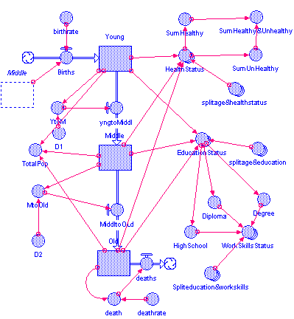
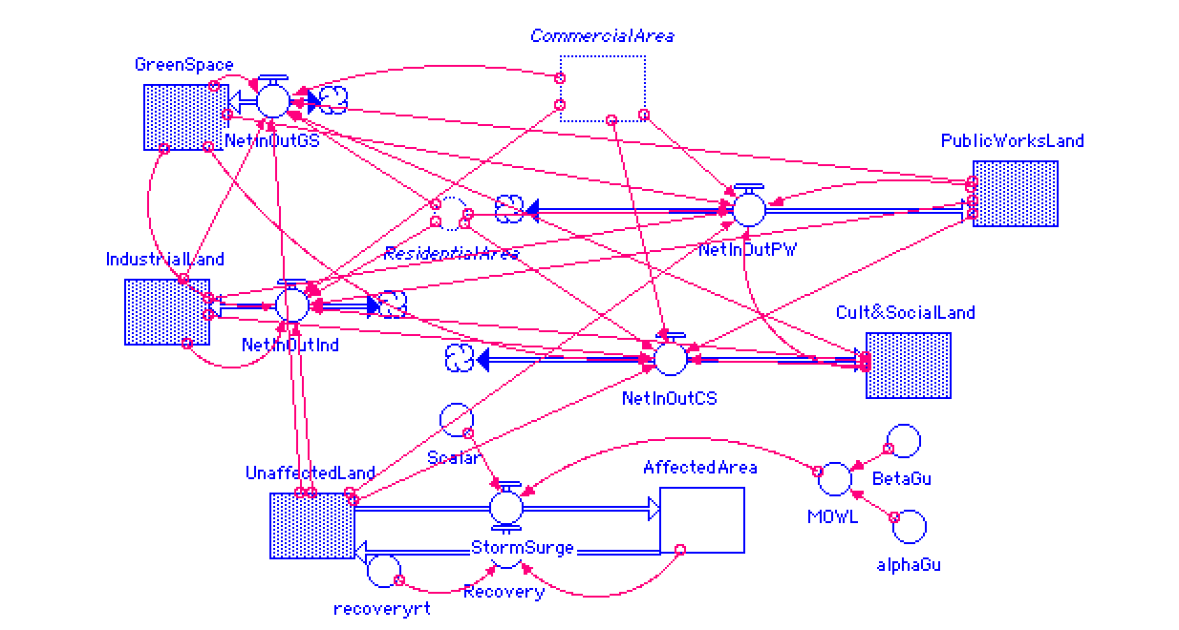
Systems Dynamics View – STELLA (Beigzadeh 2014)

Slide 20
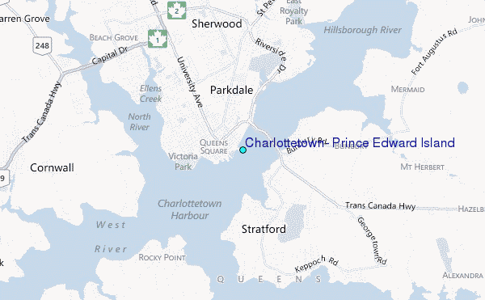
City of Charlottetown

Slide 21
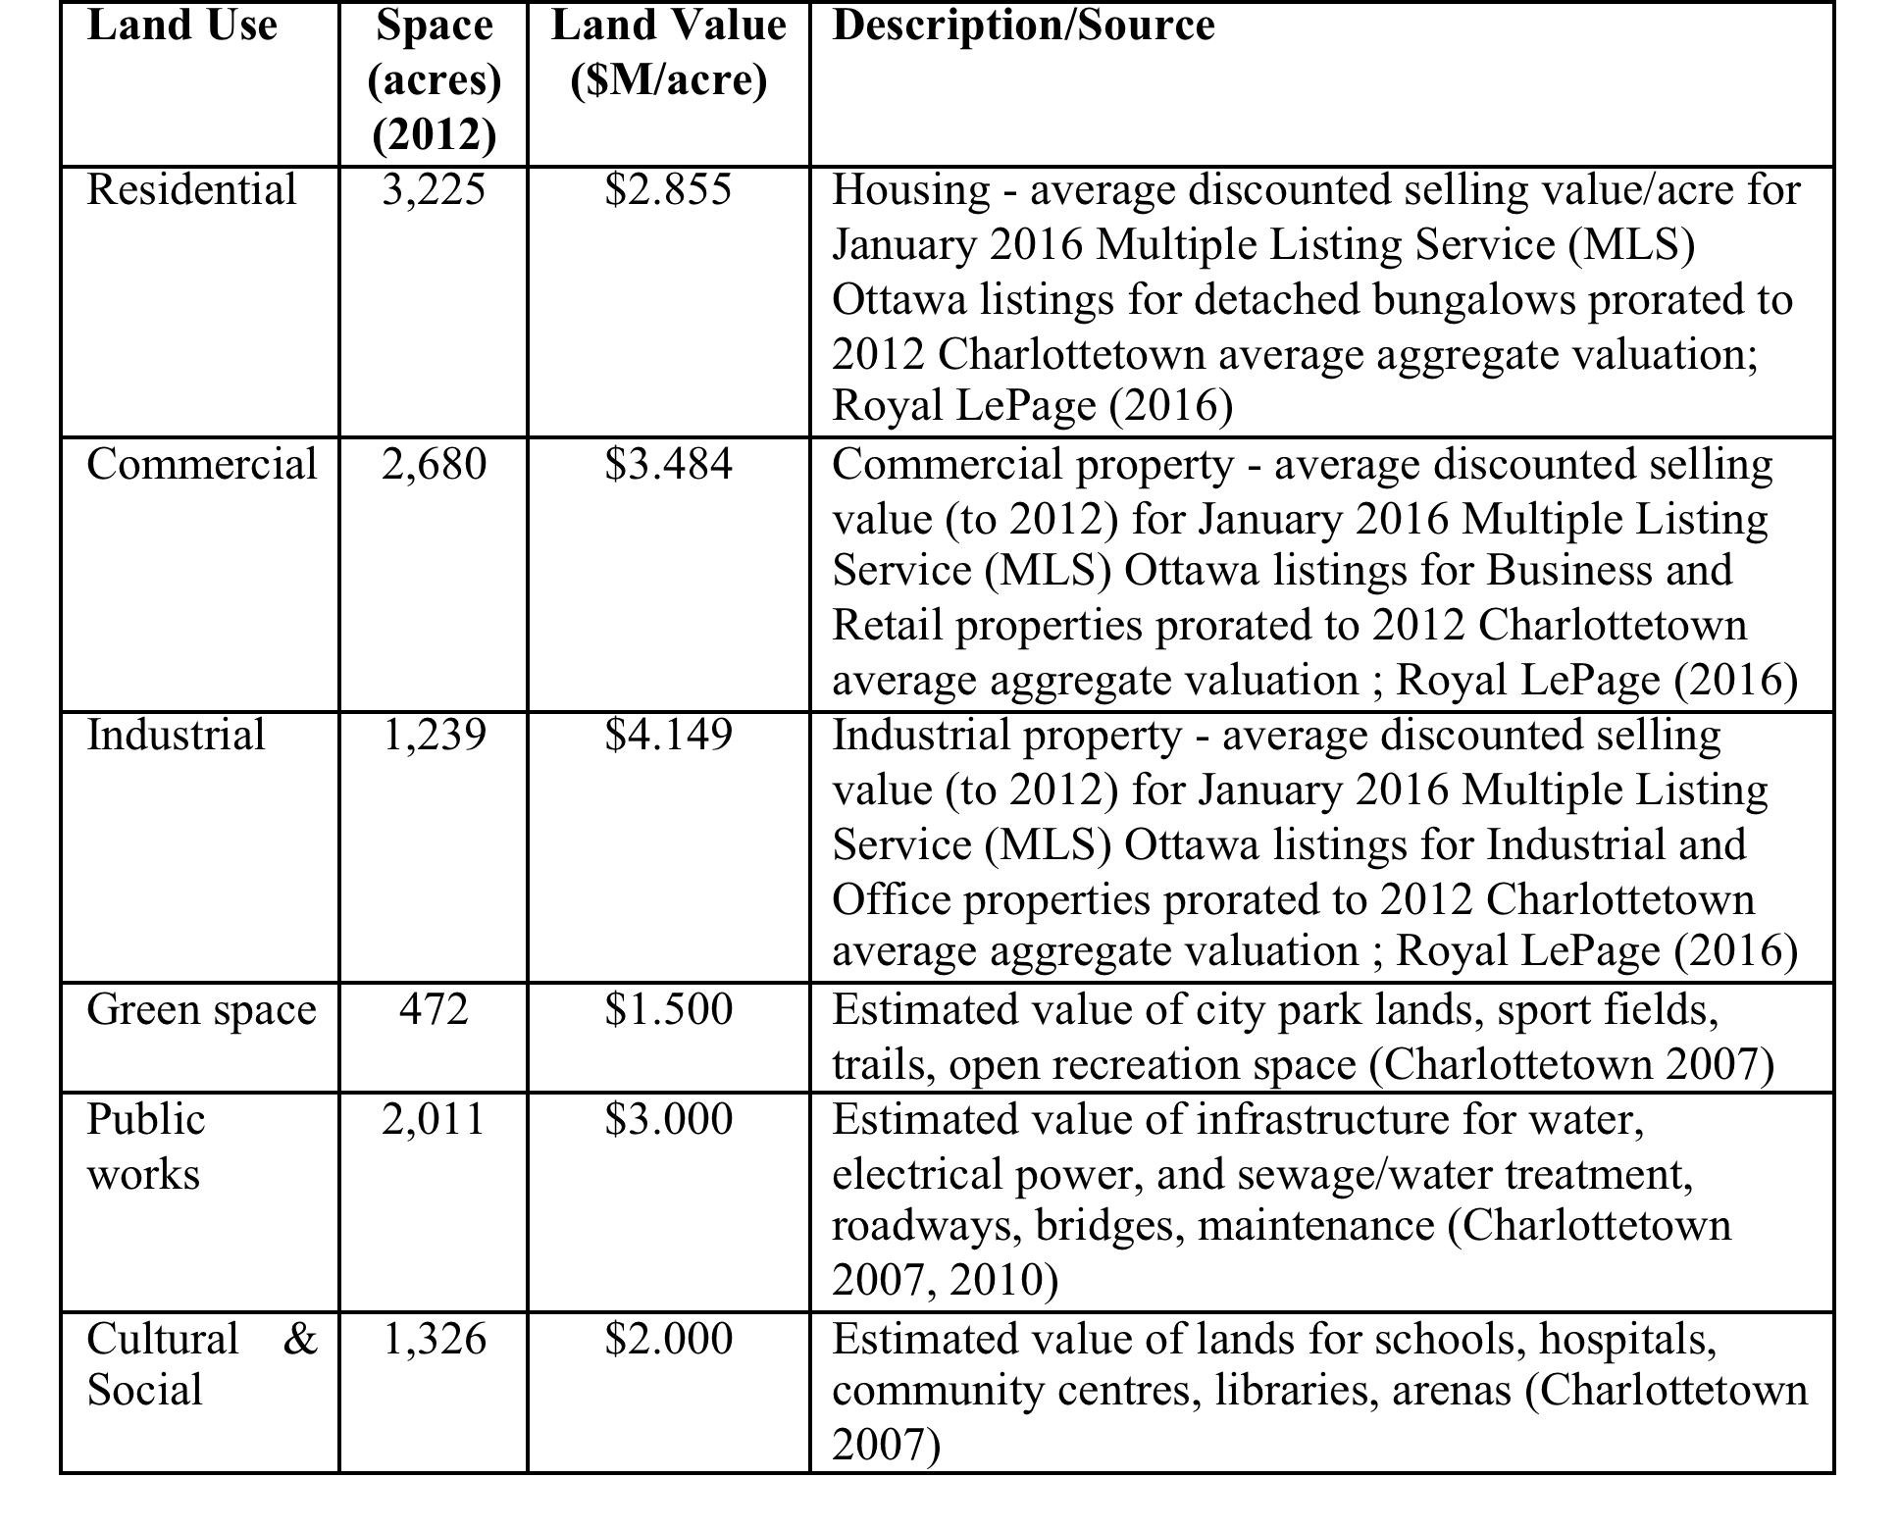
Charlottetown Attributed Land Value Assets

Slide 22
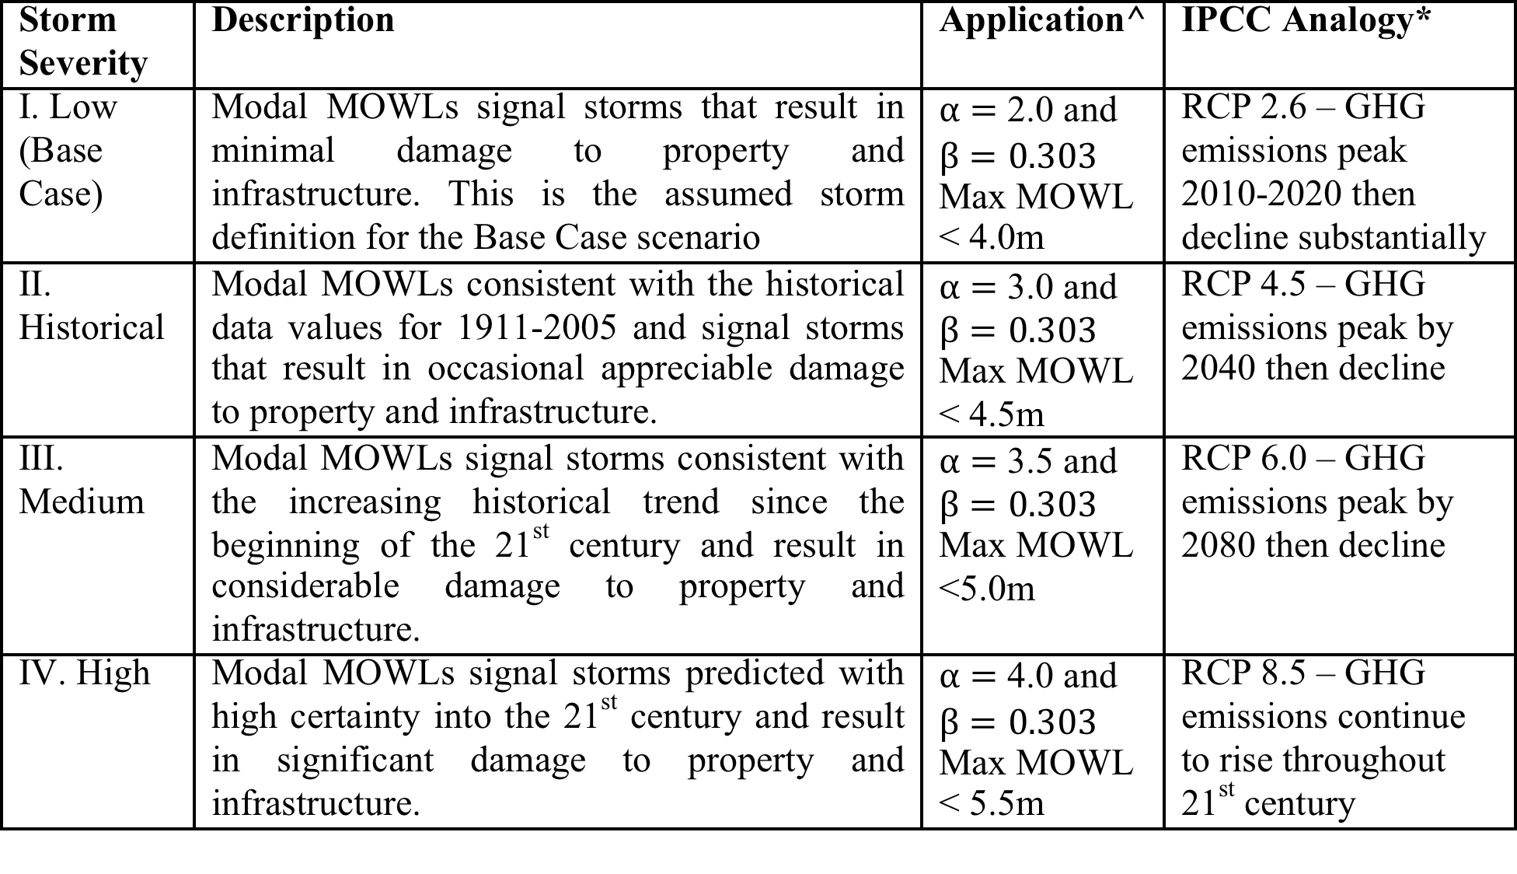
Charlottetown Annual Storm Levels, MOWL

Slide 23
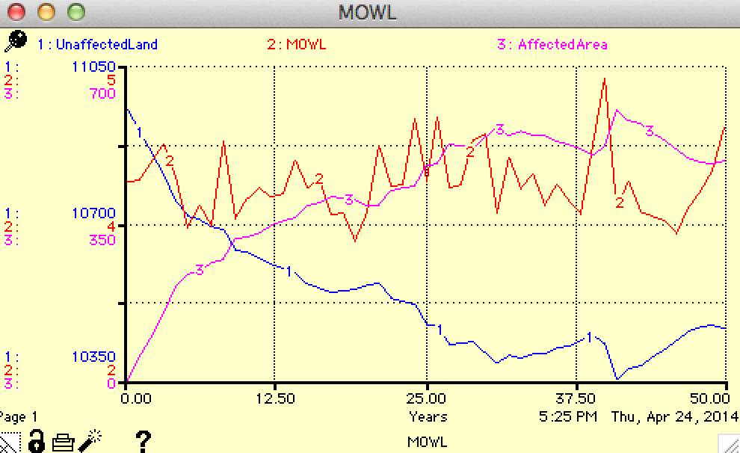
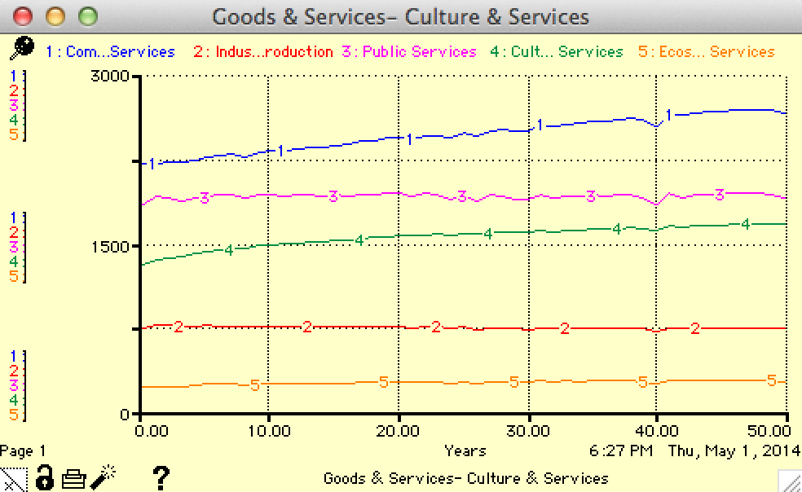
System Dynamics View – STELLA Results

Slide 24
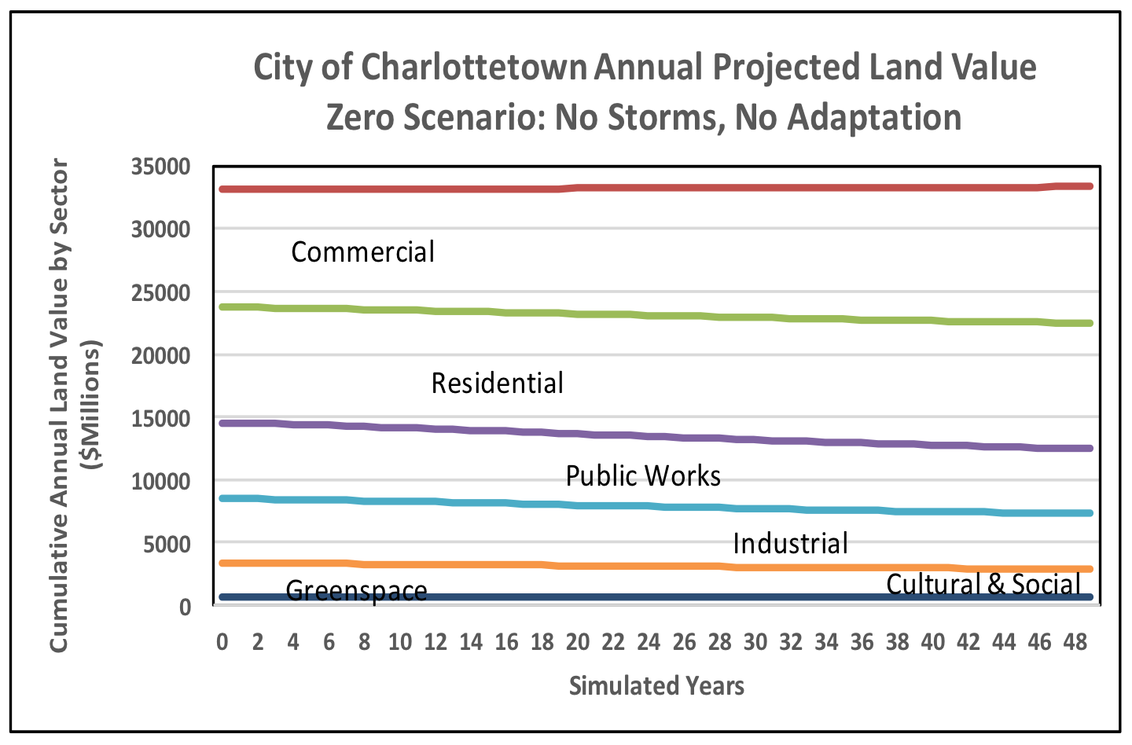
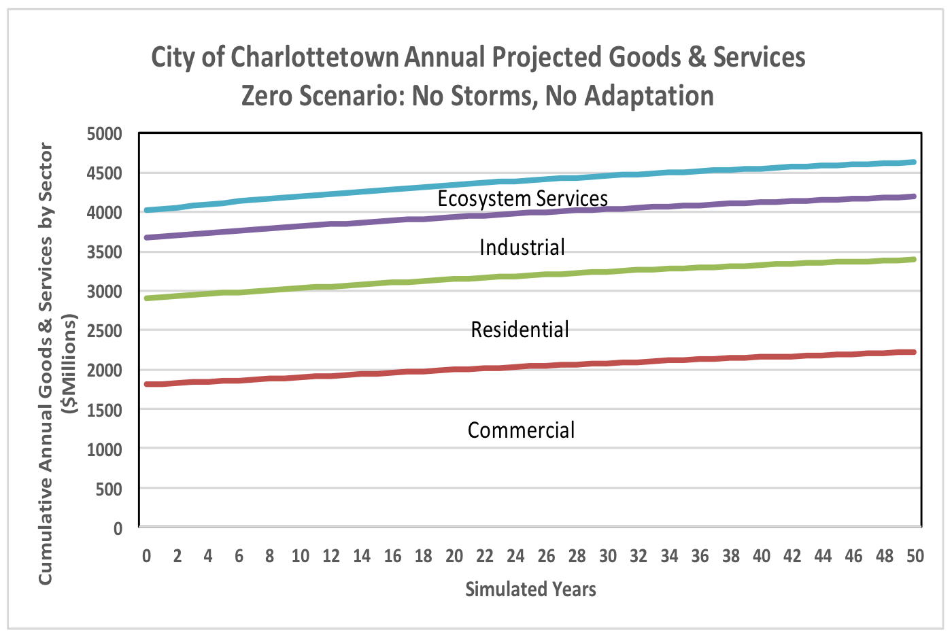
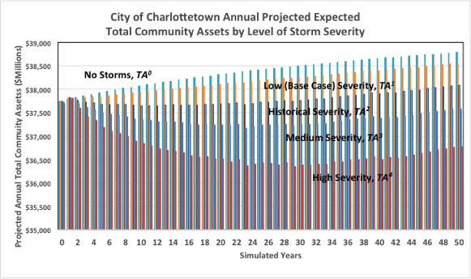
Charlottetown Profile SD Results

Slide 25
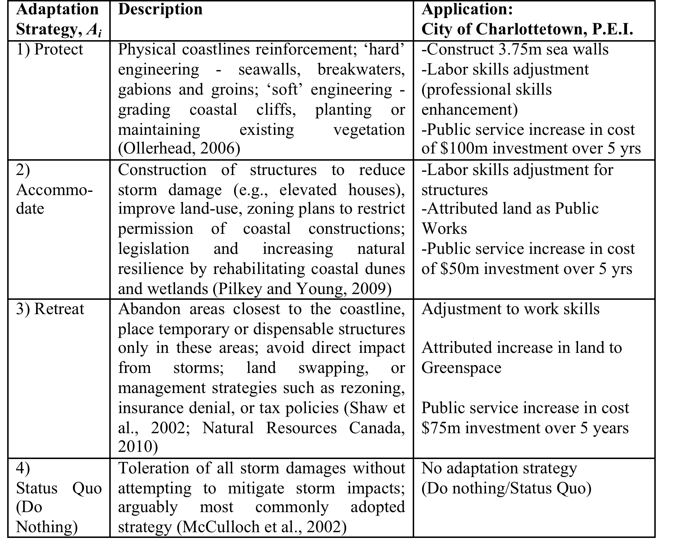
Charlottetown Controls

Slide 26
Charlottetown Simulation Scenarios
No. | Scenario Name | Controllable Variables – Adaptation Strategies for Charlottetown | Uncontrollable Variables – IPCC Analogy/Storm Severity for Charlottetown
R0 | Base Case/ Benchmark | No adaptation strategy (Do nothing/Status Quo) | Low severity storms, IPCC, RCP 2.6: 2.0 and
R1 | Worst Case | No adaptation strategy (Do nothing/Status Quo) | High severity storms, IPCC, RCP 8.5: 4.0 and
R2 | Protect–Worst Case Storms | Protect with 3.75m seawalls Labor skills adjustment for sea walls construction (professional) $100m investment in 5yrs | High severity storms, IPCC, RCP 8.5: 4.0 and Strategy modification: IF MOWL<3.75m then ‘No Impacts’ ELSE ‘Impacts’
R3 | Accommodate – Worst Case Storms | Labor skills adjustment Attributed land as Public Works Public service increase cost $50m investment in 5 years | High severity storms, IPCC, RCP 8.5: 4.0 and Strategy modification: New MOWL = .75 Original MOWL
R4 | Retreat – Worst Case Storms | Adjustment to work skills Public service increase cost Increase in Greenspace $75m investment in 5 years | High severity storms, IPCC, RCP 8.5: 4.0 and
R5 | Accommodate –Historical Storms | Labor skills adjustment Attributed land as Public Works Public service increase $50m investment in 5 years | Historical severity storms, IPCC, RCP 4.5: 3.0 and Strategy modification: New MOWL = .75 Original MOWL

Slide 27
8. Evaluating Decisions

Slide 28
Indicators for Evaluation of Strategy Alternatives
Static analysis – AHP application, multiple participants (SEPS paper)
Dynamic analysis – SD model over strategic planning period (50 years)
Vulnerability – expected storm damage estimates by sustainability pillar
Resilience – function of adaptation strategy as reduction of ‘no action’ vulnerability
Adaptive Capacity – resilience (reduced vulnerability) as a proportion of total vulnerability

Slide 29
Vulnerability Gap with Strategy
Community Asset Status
Worst Case (High severity storms)
Ideal State (No storms)
Vulnerability, V(0)
TA(0)
TA*
Resilience, R(A)
Vulnerability, V(A)
TA(0)<TA(A)<TA*
Adaptive Capacity: AC(A) = RA(A)/V(0)

Slide 30
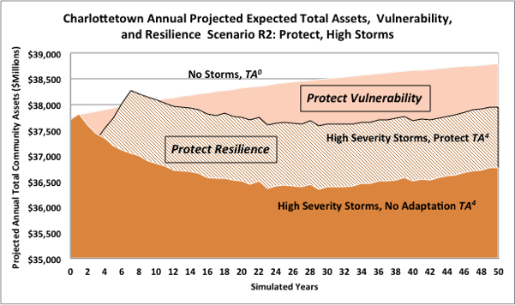
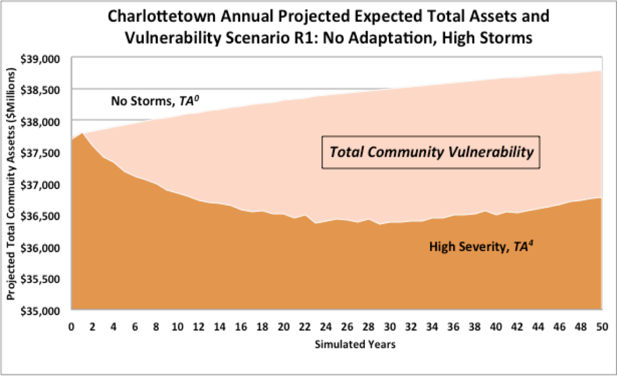
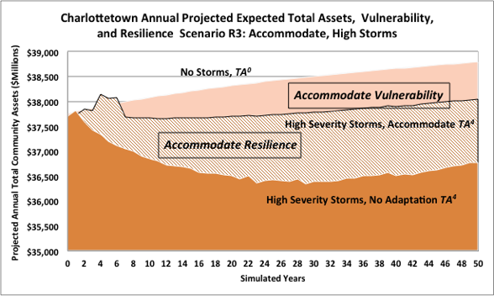
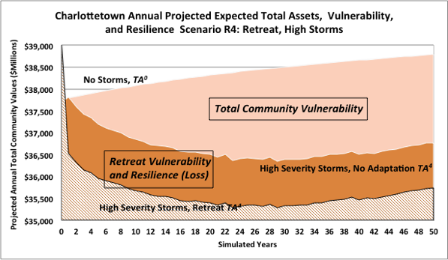
Charlottetown Storm Simulation Results:
Vulnerability & Resilience

Slide 31
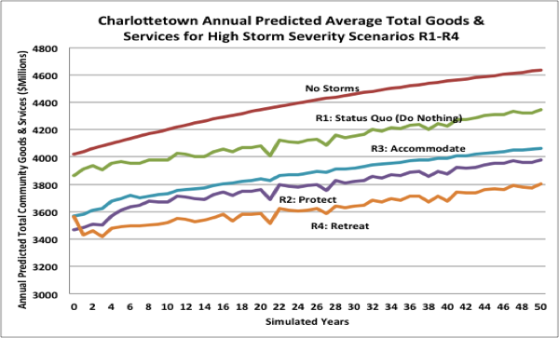
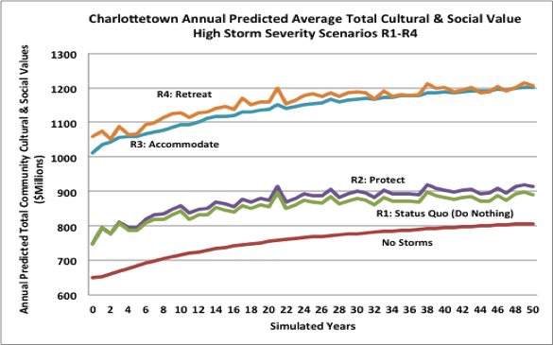
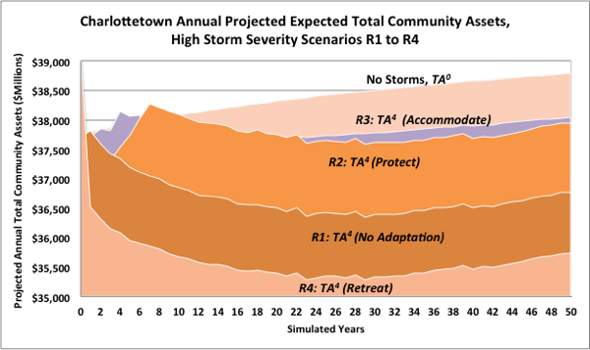
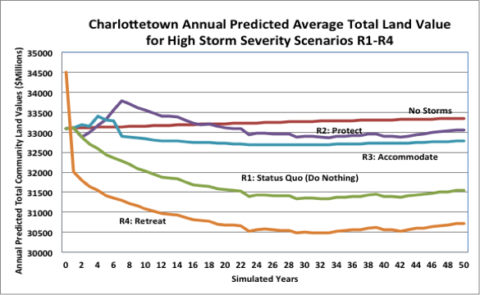
Charlottetown Storm Simulation Results

Slide 32
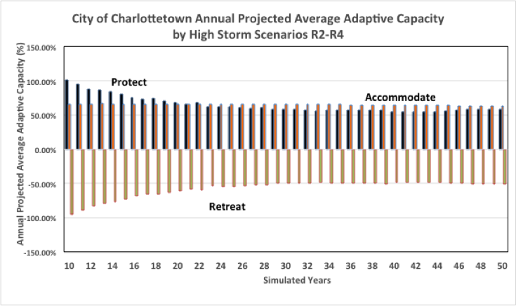
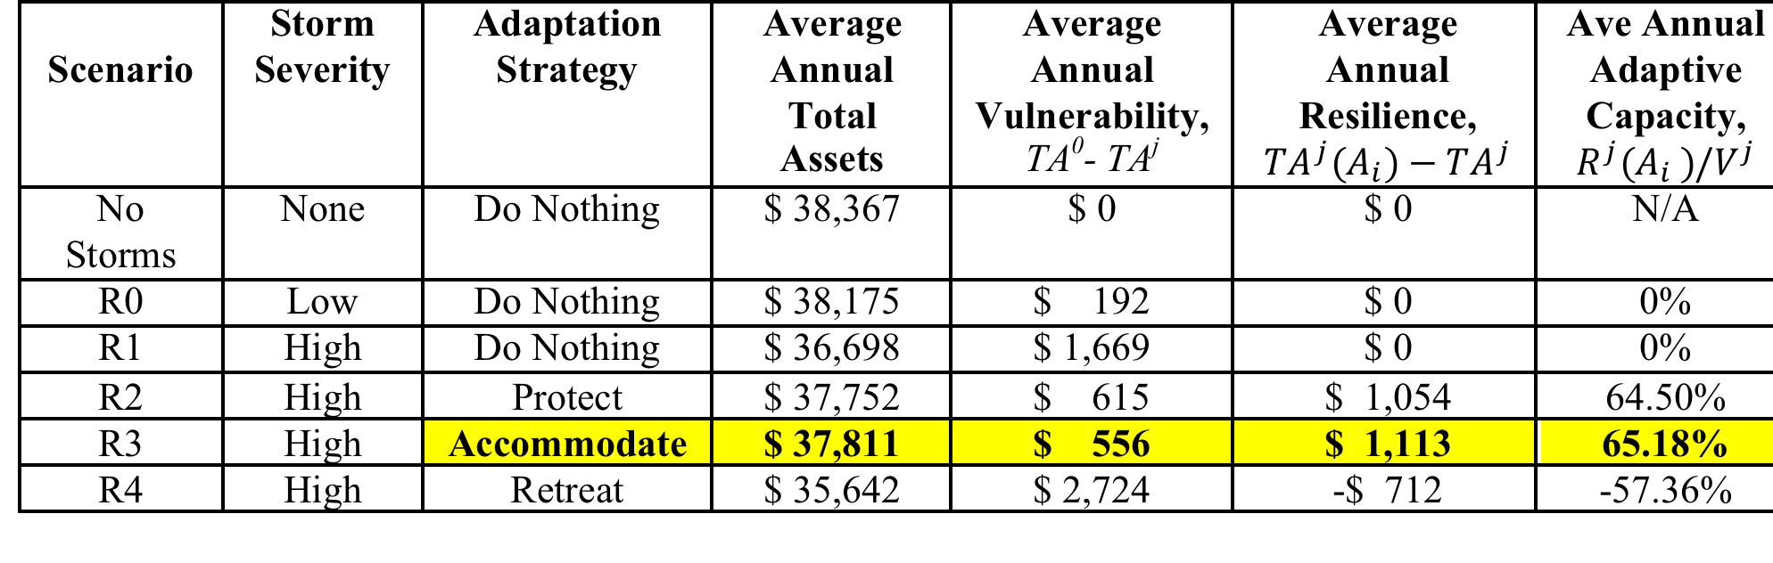
Charlottetown Storm Simulation Results: Adaptive Capacity

Slide 33
Evaluating Weighted Assets by Profile Priorities
Different communities/nations have different priorities re the Pillars of Sustainability
Requires weighting the asset results corresponding to each adaptation scenario
Consider analysis of the Charlottetown problem weighted by the China-ASEAN 1st Academy
Note similarities and differences among weights and preferred adaptation strategy options

Slide 34
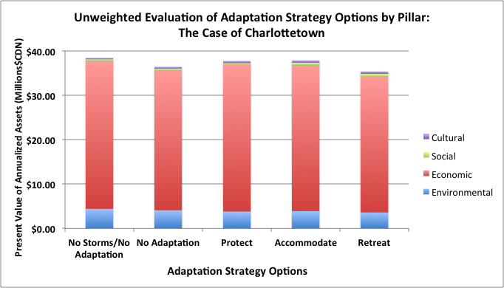
No Weights- Annualized Strategy Evaluation

Slide 35
Participants’ Exercise – Decision Evaluation

Slide 36
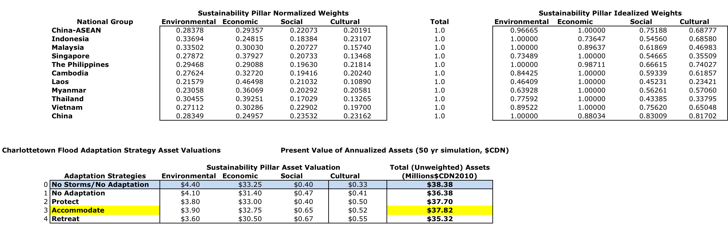
Annualized Strategy Evaluation – table form with weights

Slide 37
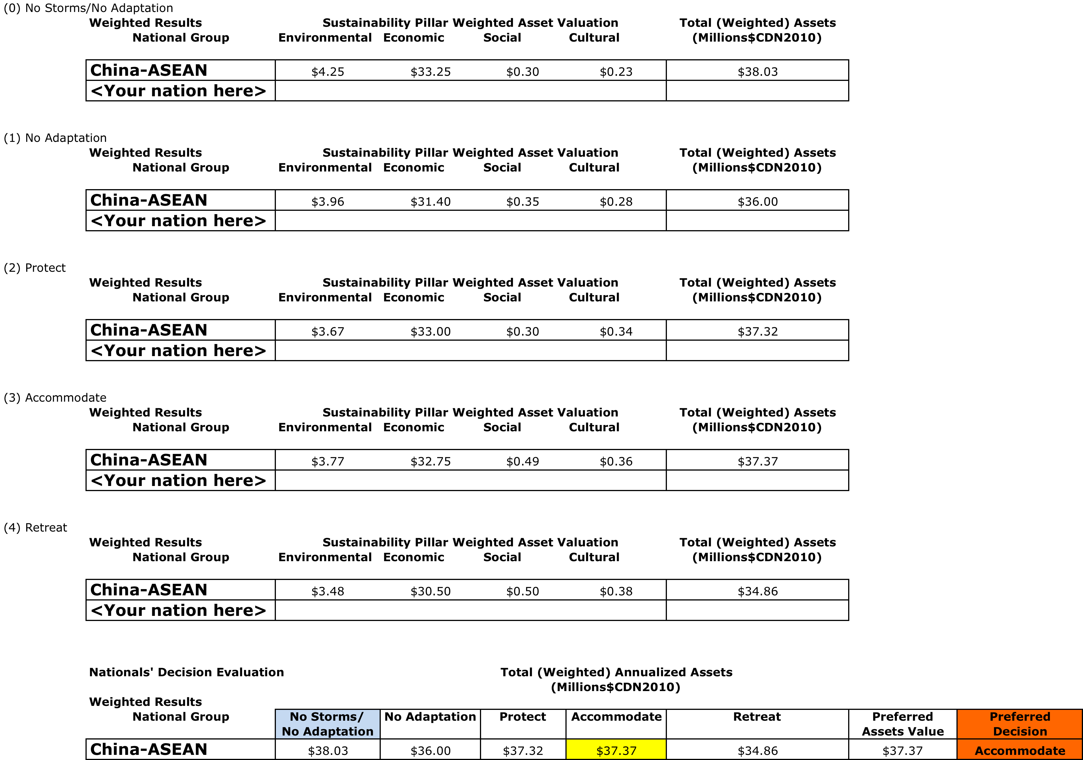
Decision form – to be completed by selected nation

Slide 38
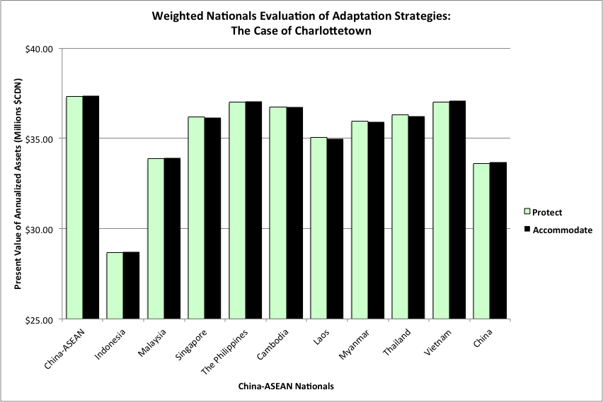
Weighted Nationals Evaluation

Slide 39
C-Change Little Anse Breakwater Workshop, May 1, 2014
Chung (2014)

Slide 40
Dimension | Attribute | Charlottetown | Isle Madame | Gibsons | Iqaluit
(1) Plans, Local Governance & Social Services (0.129) | Preparedness Planning (0.60) | 0.734 | 0.464 | 0.339 | 0.339
 | Local Governance (0.20) | 0.750 | 0.450 | 0.450 | 0.450
 | Social Services (0.20) | 0.200 | 0.800 | 0.800 | 0.000
(2) Training, Education & Community Awareness (0.259) | Capacity Building (0.50) | 0.500 | 0.500 | 0.250 | 0.375
 | Public Awareness (0.50) | 0.467 | 0.305 | 0.263 | 0.473
(3) Resources & Emergency Services (0.195) | Incident Command Sys. (0.333) | 1.000 | 1.000 | 1.000 | 1.000
 | Resources (0.333) | 0.567 | 0.279 | 0.279 | 0.246
 | Emergency Operations (0.333) | 0.334 | 0.334 | 0.334 | 0.334
(4) Communication & Collaboration (0.195) | Early Warning & Public Information (0.666) | 0.647 | 0.500 | 0.433 | 0.373
 | Community Collaborative Networking (0.333) | 0.600 | 0.800 | 0.500 | 0.700
(5) Monitoring & Forecasting (0.221) | Data Collection & Management (0.20) | 0.333 | 0.111 | 0.167 | 0.056
 | Hazard & Vulnerability Analysis (0.40) | 0.820 | 0.489 | 0.410 | 0.302
 | Environmental Forecasting (0.40) | 0.778 | 0.389 | 0.389 | 0.611
Aggregate Preparedness & Response | Index Value | 0.609 | 0.477 | 0.396 | 0.427
Community
Prepared-
ness
Index
Chung,
Mercer Clarke
and
Lane
(in progress)

Slide 41
Conclusions toward improved community resilience:
Enable community collaboration
  Designing ‘community neighborhoods’; cell phones to inform community members or their neighbors’ status and needs Lu(2013)
Encourage social networking activities
  increasing access and basic training of community members in electronic and other social networking and communication activities (e.g., Facebook, Twitter)
Support wellness, recreational lifestyle activities (Anielski, 2009)
Develop community logistics for emergency events Liu(2014)
Emergency preparedness workshops Chung(2014)
  Table Top exercise to inform local residents of the available emergency procedures and support, engage volunteer contributions and participation of community members
Disseminate preparedness to local schools to inform families

Slide 42
9. Climate Change Goverance

Slide 43
Climate Change Management
Global Governance
  UNFCCC, IPCC, COP21 (Paris), COP22 (Marrakech)
  Sendai Framework on SIDR
International Protocols
Canadian Initiatives
Community Participation and Response

Slide 44
UNFCCC COP21 – Paris Accord
To keep global temperatures "well below" 2.0C (3.6F) above pre-industrial times and "endeavour to limit" them even more, to 1.5C
To limit the amount of greenhouse gases emitted by human activity to the same levels that trees, soil and oceans can absorb naturally, beginning at some point between 2050 and 2100
To review each country's contribution to cutting emissions every five years so they scale up to the challenge
For rich countries to help poorer nations by providing "climate finance" to adapt to climate change and switch to renewable energy.

Slide 45
Paris Accord - Reaction
Canada: Ottawa’s climate-change focus now turns to reaching a detailed national climate strategy with the provinces by early March 2016 while also moving toward a North American agreement on energy and environmental issues;
China: Xinhua called the deal “a particularly sweet victory for China, which emerged to take a leading role” in the negotiations. China’s recent commitments on climate change as a sign of its new role as a world leader. In the past year, China has signed climate change agreements with the United States and France; submitted an Intended Nationally Determined Contribution to the UN, pledging to have emissions peaks by 2030; and committed 20 billion RMB ($3.1 billion) to help developing countries deal with climate change.
ASEAN: A special working group on climate change focuses on addressing climate change in the global community. ASEAN acted in advance of COP21 (November 2015) in support of a global accord.

Slide 46
UNFCCC COP22 (Marrakesh)
Integrated Coastal Management at the centre of meeting in the Moroccan Pavillion at COP22 (http://cop22.ma/en/#actualites/integrated-coastal-management-at-the-centre-of-meeting-in-the-moroccan-pavillion-at-cop22 )
The effects of global warming on water and the climate on Islands (http://cop22.ma/en/#actualites/the-effects-of-global-warming-on-water-and-the-climate-on-islands )
Cities, Towns, Regions Partner to Achieve Paris Goals (http://newsroom.unfccc.int/climate-action/cities-towns-regions-partner-to-achieve-paris-goals/
Action for Climate Empowerment (http://unfccc.int/cooperation_support/education_outreach/overview/items/8946.php )
Climate Action Now – Summary for Policy Makers 2016 (http://climateaction2020.unfccc.int/media/1281/unfccc_spm_2016.pdf )

Slide 47
Sendai Framework
Disaster Risk Reduction (weather events related)
Hyogo Framework for Action 2005-2015: Building the resilience of nations and communities to disasters
Sendai framework (2015) – endorsed by the UN General Assembly following the 2015 3rd UN World Conference on Disaster Risk Reduction (WCDRR)
“The Sendai Framework is a 15-year, voluntary, non-binding agreement which recognizes that the State has the primary role to reduce disaster risk but that responsibility should be shared with other stakeholders including local government, the private sector and other stakeholders.” UNISDR Website

Slide 48




International protocols
Some International organizations developing plans for climate change protection.
UNDP
ICLEI
CARE
FCM
China-ASEAN Advanced Academy on Oceans Law and Governance

Slide 49
Local Community Response
Resource needs
Bottom up
Community participation - recycling, reusing, good practices

Slide 50
References/Websites
NASA National Aeronautic and Space Administration (USA) - http://www.nasa.gov/mission_pages/noaa-n/climate/climate_weather.html
2016-01-23 07:48:38 Cold Weather to Continue into New Week - CRIENGLISH.com Web Editor: Wang Kun http://english.cri.cn/12394/2016/01/23/4203s914225.htm
IPCC, 2013: Summary for Policymakers. AR5. https://www.ipcc.ch/report/ar5/
ASSESSMENT OF CANADA’S MARINE COASTS - Natural Resources Canada document in development (2016) http://www.nrcan.gc.ca/environment/resources/publications/10766
COIN (Coastal and Ocean Information Network) Atlantic (Canada) – Coastal Sensitivity to Sea-level rise http://coinatlantic.ca/index.php/climate-change/sea-level-rise
Guangdong Sea Level rise – Globe and Mail Report, December 5, 2015 http://www.theglobeandmail.com/news/rising-waters-prompt-chinas-sea-change-onclimate/article27608966/
Report of the UN Conference on Sustainable Development - Rio de Janeiro, Brazil, June 20-22, 2012 http://www.uncsd2012.org/content/documents/814UNCSD%20REPORT%20final%20revs.pdf
Coastal Zones: Solutions for the 21st Century – Chapter 9 – Managing Adaptation to Coastal Climate Change https://books.google.ca/
Introduction to System Dynamics – System Dynamics Society (NY, USA) http://www.systemdynamics.org/what-is-s/
ArcGIS, Esri Systems - https://www.arcgis.com/features/
STELLA SD Software, ISEEE Systems - http://www.iseesystems.com
Vensim SD Software, Ventana Systems, Inc. - http://vensim.com
International Society on Multicriteria Decision Making (INFORMS) - https://www.informs.org/Community/MCDM ; http://www.mcdmsociety.org
  AHP Software – Expert Choice - - http://expertchoice.com/about-us/our-decision-making-methodology/
  C-Change Website and thesis, working papers - http://www.coastalchange.ca
  C-Change Facebook site - https://www.facebook.com/coastalchange/
  Ocean Management Research Network (OMRN) website - https://www.facebook.com/pages/Ocean-Management-Research-Network-OMRN/75437331234?fref=ts
  Sendai Framework for Disaster Risk Reduction, UNISDR - http://www.unisdr.org/we/coordinate/sendai-framework
  Hyogo Framework for Action 2005-2015: Building the resilience of nations and communities to disasters - http://www.unisdr.org/we/inform/publications/1037
  UNFCCC COP21 Paris website - http://unfccc.int/documentation/documents/advanced_search/items/6911.php?priref=600008831
  IRENA & ACE (2016). Renewable Energy Outlook for ASEAN: a REmap Analysis. International Renewable Energy Agency (IRENA), Abu Dhabi and ASEAN Centre for Energy(ACE),Jakarta- http://www.aseanenergy.org/resources/publications/renewable-energy-outlook-for-asean-a-remap-analysis/

Slide 51





Questions/Discussions

